Slide 1
Childcare Connect

Slide 2
Introduce the team
Chris Liah Suzelle
Bruce Obaid
Notes:
[Chris]

Slide 3
What’s the problem?
Daycare programs are rigid - they require months of commitment, weeks of waiting lists and do not accommodate changing childcare needs..
For parents
70% of working parents have children under five years old
Limited spaces for 19% of children aged 0 to 12
Hard to find accessible services for infants, toddlers, children with disabilities and aboriginal children
Childcare is also the second-highest expense after housing: $40-$60 a day on average, $1500 per month in Toronto
Difficulties finding accessible and affordable childcare during pandemic
For ECEs
Only earn 55% of the wage of comparably educated workers
Many of them leave the sector altogether
Decreased job opportunities during pandemic
Notes:
Suzelle, scalability and the need for *stat # about ontario children

Slide 4
User Research
Online survey for parents
Broad range of childcare needs - 4 hours to 60 hours per week
ECE credential improved parent comfort level by 33%
New findings: children’s feedback, proof of credentials
User Interview with Caley Drake RECE
Reported high childcare provider burnout
Before and after daycare is the most common, but least attractive shift
Notes:
Suzelle
Let’s outline the hypothesis. And be more specific about key findings - marketing
-What valuable data are we specifically going to mention - what is a frustration she had about the current system?

Slide 5
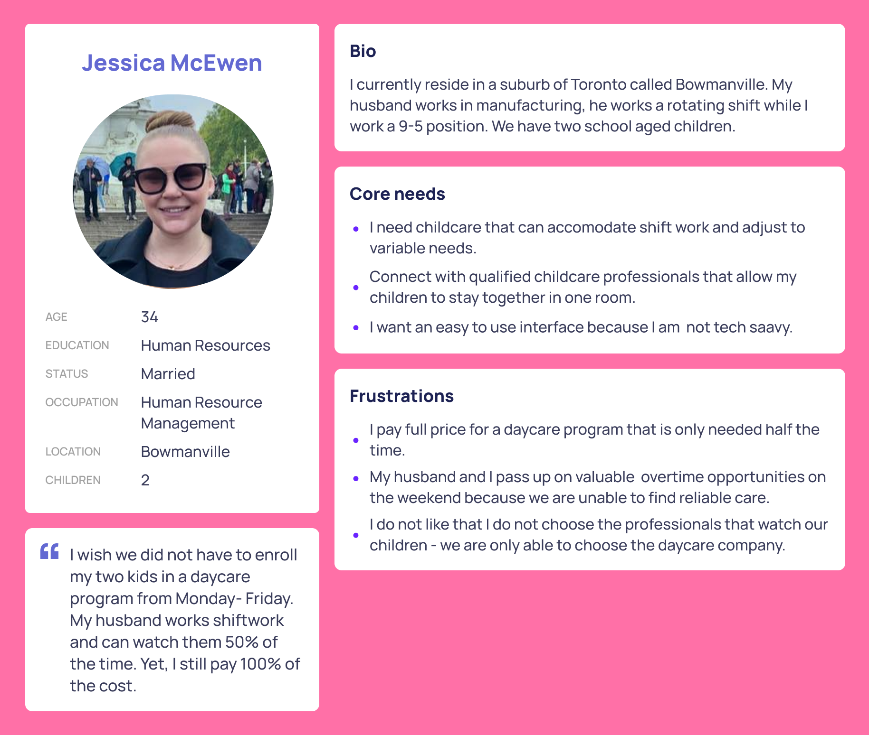
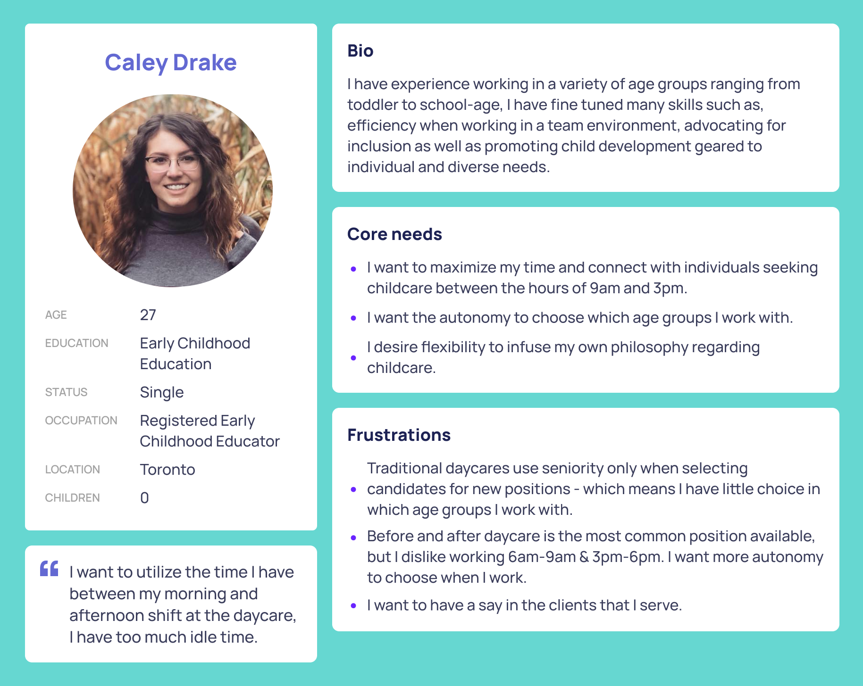
User Personas based on real users
Notes:
Suzelle

Slide 6
What’s our users needs and pain points?
Parents
Needs: childcare service can accommodate with their shift work and adjust to variable needs, affordable cost, high quality service, and an efficient way to find accessible childcare service
Pain Points: accessibility, high costs, not being to work out of the traditional system
ECEs
Needs: flexible working schedule, able to apply their own philosophy in service, self-autonomy
Pain Points: inflexible working hours in the traditional system, limited work choices, lack of career growth
Notes:
Suzelle
Needs: let’s open up the topic of shift work to be more general - for example, In 2021, many parents have professions that do not comply with a 9-5 schedule Monday-Friday.

Slide 7
Challenge Statement
Parents and ECEs want access to flexible childcare hours because of the rigidity of the current daycare system
Notes:
Suzelle

Slide 8




Competitive Landscape
Licensed
Childcare Centres
Childcare Agencies
Before-&-After School Programs
Unlicensed
Babysitters
Nannies
Other Parents
Notes:
[Chris]
COVID vaccination as factor for Unlicensed Childcare

Slide 9
Existing Digital Solutions Within the Same Space
Daycare Connection
Focusing on licensed home care (licensed + unlicensed) matching
Careconnect Network
Make booking with daycare centers easier through online booking
Childcare ConnectTM (not us)
Digital agency that helps providers find opportunities in their local areas
Care
Allow parents to create job postings on a board for providers to apply to
OneList (Waterloo/Kitchener)
Digitized licensed childcare matching service for BnA
User gets to choose their top picks for services available in their local region
Notes:
[Chris]
Basic Pro & Con explanation
Daycare Connection
Form submission based onboarding, both unlicensed and licensed providers can sign up
Careconnect Network
Substitution network, no autonomy
Care
Quality of service would be random
While being able to get applicants, there’s no certainty anyone who fits requirements would see the application in time (doesn’t work well with less time constraints)
Childcare Connect
Helps qualified individuals find jobs more easily (parent side of the equation not fulfilled)
Onelist
its only for B&A, only waterloo kitchener

Slide 10
Identifying the Gap & Opportunities
Notes:
Chris

Slide 11
Feasibility - Can the proposed solution be implemented? Are there any critical barriers?

Slide 12
Potential solutions: What’s our top 3 ideas?
Selloff vacations for daycare service
Pros: work in the current system
Cons: poor flexibility, vacancies are random, too last minute
Home childcare with housewives
Pros: create job opportunities for women
Cons: lack credentials and safety concerns
Gig works for ECEs
Pros: high flexibility, high quality service, sustainable
Cons: need for transition from existing system
Notes:
Suzelle
Explain the what we mean by selloff vacations in the daycare context

Slide 13
Potential for Impact - How will this project help move the world towards mitigating the impact of COVID-19 on businesses going forward?
Notes:
Suzelle

Slide 14
Solution showcase
Show by video? Mockups? Screens? - TBD
(what I am going to talk about the design)
Branding (like how we come up with the colour, any meaning? How we combine those colours without making it a mess etc.)
Following by user flow: homepage, registration, searching by filter, providers profile
Refinements: additional safety features for ECEs, chat function to facilitate the conversation between both parties
Notes:
Liah
Somebody presentation slides -> recorded (Liah sharing her screen -> Bruce sharing his screen) -> sharing presentation slide

Slide 15
Value proposition
Our digital child care connecting platform
help(s) parents/guardians
who want to find affordable child care
by avoiding long-term commitment, removing wait times
and enabling flexibility, providing autonomy and control
Notes:
Obaid
Our online platform Childcare Connect,
Helps parents connect with ECEs
Who want to find flexible childcare solutions
By avoiding traditional daycare systems that require long term commitment and waitlists
Value proposition according to the format

Slide 16
Benefits of our solution
Flexible option for parents/guardians unable to afford long term child care due to work and/or finances.
Faster approval for those unable to find a child care service in their vicinity or waitlisted parents/guardians.
Parents/Guardians saving time by not making trips to the child care facility or due to lack of personal/accessible transportation.
Occasional users not able to find a sitter/family/friend to look after their child.
Additional source of income for registered ECEs not getting enough hours or just wanting to work more.
Flexible and independent work options for ECEs
Notes:
Obaid
Parent Benefits
ECE benefits

Slide 17
Customer Centric Strategy
Acquiring Customers:
Google pay-per-click ads
Facebook ads targeting audiences from certain Locations, Demographics, Behaviour, & Interests
Word-of-mouth
Developing Loyalty:
Providing a smooth sign-up process and constantly improving overall customer experience
Rewards program
Feedback
Repeat Customers & Advocacy:
Reviews & testimonials
Referral bonus
Encourage social media interaction on company’s posts
Notes:
Obaid

Slide 18

Risks
Early Childhood Educator’s & children’s safety on-site
Geolocation tracking
Live chat/video with the ECE
Feedback
Property’s safety & liability
Notes:
Obaid
Parent and ECE surveys - they provide insight about safety, cleanliness of home, responsiveness of children
Adoption of digital source for childcare - we will need to reiterate designs frequently to ensure our users want to transition to this digital system

Slide 19
Mitigating Risks
Problem: ECE registering is the actual person and not an imposter.
Solution: ECE Registration Number verification in the registry, live video verification of the person with their ID.
Problem: Users registering for the service being the parent/guardian of the child and legally residing in the property they request childcare services at.
Solution: Verification of ID, address proof, proof of relationship with the child.
Notes:
Obaid

Slide 20
Key Metrics and Traction
Traction
Conversion (monthly traffic divided by # of total registrations)
Ratio of parent requests (measured in hours) to available ECEs on platform (measured in hours)
Monthly user activity
Customer Acquisition Cost (CAC) & Life time value (LTV)
Using Google Analytics
For Parents
Satisfaction survey post visit
Referral program
Number of childcare visits needed per month (measured in total hours)
CAC = referral program + google ad campaign + email marketing cost (mailchimp) + Facebook ads
Sum/# of parent sign ups
Notes:
Liah
Google ad campaign = Customer Acquisition cost: Highest volume traffic includes the term Daycare
"daycare" = $2.88
"daycare near me" = $4.83
"daycare ontario" = $2.61
Childcare
"Daycare toronto" = $2.46
"childcare" = $2.50
"childcare near me" = $3.07
"Childcare jobs" = $2.01
Email marketing = $500
-Table?
Ratio of parent requests to available ECE is important for balancing marketing efforts

Slide 21
Our Roadmap - Core Value
We believe “autonomy” is the most important value for our parents and children side but also childcare provider side, so that they can find or give the service you want.
Parents & Children
Childcare-Connect
Childcare Provider
Notes:
[Bruce]

Slide 22
Our Roadmap
Q1
Q2
Q3
Q4
M1
M2
M3
M4
M5
M6
M7
M8
M9
W1
W2
W3
W4
Goals
Planning
Research
Development
Marketing
Launch the fully functioned website
Have 1000 parents and 100 ECE registered in first 3 month; Improve SEO ranking
Have 3000 parents and 300 ECE registered, launch the mobile app
Launch the pilot programing in Toronto area
Launch the pilot programing on Ontario
Choose go to NFP or corporate option
Had enough iteration cycles through usability testing with parents and ECE
Have user interviews and survey to synthesis qualitative research
Conduct user analytic, like DAU (daily active users), user satisfaction, sales trends, customer service feedback
Develop a landing page, database, messaging, payment, feedback system, verification/authentication system
Develop the mobile ios app
Maintain and help encrypt the data for user privacy and confidentiality
Set up social network account like facebook, twitter, linkedin, instagram, tiktok, Google Ad/ Email campaign
Launch the referral program to motivate new users
Create content on daily basis to promote, initiate marketing in broader areas
LOREM
Notes:
[Bruce] Needs grammar improvement
NFP: there is an upcoming infusion of billions of dollars into flexible childcare options - Currently there are no flexible daycare options - we aim to provide proof of concept by launching our pilot program

Slide 23
Our Roadmap - budgeting
From government funding
Funds
Angel Investor/ VC funds
What resources do we need
Donation/ Grants
Government policies supports
Social support
Local communities’ support
Notes:
[Bruce]

Slide 24
Our Roadmap - Budgeting (Annual)((Annual)Annual)(Annual)
Operating Expenses
Set up business: LLC & Corporations - $500
Business Insurance, Permit and License Fees - $2500
Software expense - $3000
2%
Labor Expenses
Software Engineers $70000 x 3
Designers - $60000 x 2
Marketer - $50000 x 1
Customer Service - $50000 x 1
95%
Marketing Expenses
Google/ Facebook/ Instagram Ads - $6000
Email Marketing - $2000
Influencer Marketing - $2000
3%
Notes:
[Bruce]

Slide 25
Our Roadmap - Our Limit
Scalability - Can this solution be used to impact a large number of people?
Right now, we tried to build the prototype and a usable website to show our idea. To successfully run this project, we need senior developers, business analytics and marketing specialist to deliver our product, 4 months of developing and 100K initial funds.
If we go to NFP, we can impact the Ontario area even whole Canada area.
If we go to private corporation solution, we can scale to north america.
We can work for free at our spare time and having volunteers to deliver our product within 6-12 months to ship our product.
Notes:
[Bruce]
Scalability - children and ECEs are all over Canada, it is a scalable idea, but profitability will hinder the rate of impact on a large number of people
Flexibility of scope - if we are a NFP , government grants for specific geographic areas that have childcare challenges can be addressed

